Slide 1
Chapter 4 HBase Technical Principles
Presented By: Dr.Randa Moamed

Slide 2
Foreword
This course describes the non-relational distributed database called HBase in the Hadoop open-source community, which can meet the requirements of large-scale and real-time data processing applications.
●

Slide 3

Objectives
●
On completion of this course, you will be able to be familiar with:
❐
HBase system architecture and related concepts
HBase key processes and prominent features HBase performance tuning
Basic shell operations of HBase
❐
❐
❐

Slide 4
Contents
Introduction to HBase
HBase Related Concepts
HBase Architecture
HBase Key Processes
HBase Highlights
HBase Performance Tuning
Common HBase Shell Commands

Slide 5
Introduction to HBase
HBase is a column-based distributed storage system that features high reliability, performance, and scalability.
●
HBase is suitable for storing data in a big table (the table can store billions of rows and millions of columns) and allows real-time data access.
❐
Hadoop HDFS (Hadoop Distributed File System) is used as the file storage system to provide a distributed database system that supports real-time read and write operations.
❐
❐
HBase uses ZooKeeper as the core collaboration service.
Hbase was developed based on the open source bigtable.
Big data is a table contains billions of rows and billions of columns

Slide 6
Comparison Between HBase and RDB
●
HBase differs from traditional relational databases in the following aspects:
Data indexing: A relational database can build multiple complex indexes for different columns to improve data access performance. HBase has only one index, that is, the row key. All access methods in HBase can be accessed by using the row key or row key scanning, ensuring the proper system running.
Data maintenance: In the relational database, the latest current value is used to replace the original value in the record during the update operation. The original value does not exist after being overwritten. When an update operation is performed in HBase, a new version is generated with the original version retained.
Scalability: It is difficult to implement horizontal expansion of relational databases (Scale out), and the space for vertical expansion is limited (Scale in). On the contrary, distributed databases, such as HBase and BigTable, are developed to implement flexible horizontal expansion. They can easily implement performance scaling by adding or reducing hardware in a cluster.

Slide 7
HBase Application Scenario
Data
storage
User image
Time series
data
Meteorological
data
Message/Order
storage
HBase Scenarios
Feed flow
Cube
analysis
NoSQL

Slide 8
Contents
Introduction to HBase
HBase Data Model
HBase Architecture
HBase Key Processes
HBase Highlights
HBase Performance Tuning
Common HBase Shell Commands

Slide 9
Data Model
Simply, applications store data in HBase as tables.
A table consists of rows and columns. All columns belong to a column family.
The intersection of a row and a column is called a cell, and the cell is versioned. The contents of the cell are an indivisible byte array.
The row key of a table is also a byte array, so anything can be saved, either as a string or as a number.
HBase tables are sorted by key. All tables must have a primary key.

Slide 10
HBase Table Structure (1)
create 'table_name', 'colmn_family'
create 'table_name', 'comln_family1','colmn_family2'
Column Family
Column
Info
name
age
gender
20200301
Tom
18
male
Row Key
20200302
Jack
19
male
female
20200303
Lily
20
female
t1
Cell
t2
The cell has two timestamps t1 and t2. One timestamp corresponds to one data version.

Slide 11
HBase Table Structure (2)
Table: HBase uses tables to organize data. A table consists of rows and columns. Column families are divided into several columns.
●
Row: Each HBase table consists of multiple rows, and each row is identified by a row key.
Column family: An HBase table is divided into multiple column families, which are basic access control units.
Column qualifier: Data in a column family is located by column qualifiers (or columns).
Cell: In an HBase table, a cell is determined by the row, column family, and column qualifier. Data stored in a cell has no data type and is considered as a byte array byte[].
Timestamp: Each cell stores multiple versions of the same data. These versions are indexed using timestamps.
●
●
●
●
●

Slide 12
Conceptual View of Data Storage
There is a table named webtable that contains two column families: contents and anchor. In this example, anchor has two columns (anchor:aa.com and anchor:bb.com), and contents has only one column (contents:html).
●
Row Key | Time Stamp | ColumnFamily contents | ColumnFamily anchor
"www.cnn.com" | t9 |  | anchor:aa.com= "CNN"
"www.cnn.com" | t8 |  | anchor:bb.com= "CNN.com"
"www.cnn.com" | t6 | contents:html="<html>..."
"www.cnn.com" | t5 | contents:html="<html>..."
"www.cnn.com" | t3 | contents:html="<html>..."

Slide 13
Physical View of Data Storage
Although in the conceptual view, a table can be considered as a collection of sparse rows. Physically, however, it differentiates column family storage. New columns can be added to a column family without being declared.
●
Row Key | Time Stamp | ColumnFamily anchor
"www.cnn.com" | t9 | anchor:aa.com= "CNN"
"www.cnn.com" | t8 | anchor:bb.com= "CNN.com"
Row Key | Time Stamp | ColumnFamily contents
"www.cnn.com" | t6 | contents:html="<html>..."
"www.cnn.com" | t5 | contents:html="<html>..."
"www.cnn.com" | t3 | contents:html="<html>..."

Slide 14
Row-based Storage
Row-based storage refers to data stored by rows in an underlying file system. Generally, a fixed amount of space is allocated to each row.
●
❐
Advantages: Data can be added, modified, or read by row.
Disadvantage: Some unnecessary data is obtained when data in a column is queried.
❐
We have many data storage models. By row, by column and by keyValue.
In this table (data storage model by row)
  Every row contains all attributions.
In data storage model by column. One column save all information of users……
ID | Name | Phone | Address

Slide 15
Row-based Storage
Row-based storage refers to data stored by rows in an underlying file system. Generally, a fixed amount of space is allocated to each row.
●
❐
Advantages: Data can be added, modified, or read by row.
Disadvantage: Some unnecessary data is obtained when data in a column is queried.
❐
This kind of data model calls relational database. Data can be added, modified, row by row. But It can cause useless wasting of resourse. Because if we want to find xxx. We need read row one, row two and row three. until we find this data.
ID | Name | Phone | Address

Slide 16
Row-based Storage
Row-based storage refers to data stored by rows in an underlying file system. Generally, a fixed amount of space is allocated to each row.
●
❐
Advantages: Data can be added, modified, or read by row.
Disadvantage: Some unnecessary data is obtained when data in a column is queried.
❐
data stored by column can solve this problem. If we want to find XXX. So, we only need find XXX, then by reading this column, we can find the data. Thus, data stored by column is preferred rather than data stored by row.
Hbase is a column-oriented database.
This way can be used to store massive data.
ID | Name | Phone | Address

Slide 17
Column-based Storage
Column-based storage refers to data stored by columns in an underlying file system.
Advantage: Data can be read or calculated by column.
Disadvantage: When a row is read, multiple I/O operations may be required.
data stored by column can solve this problem. If we want to find value ‘OO’. So, we only need find ‘OO’ by reading this column, we can to find the data. Thus, data stored by column is preferred rather than data stored by row.
Hbase is a column-oriented database.
This way can be used to store massive data.
ID
Name
Phone
Address
K1 |  | V1
 | K5 |  | V5
K2
V2
K3 |  | V3
 | K7 |  | V7
K4
V4
K6
V6
K8
V8

Slide 18
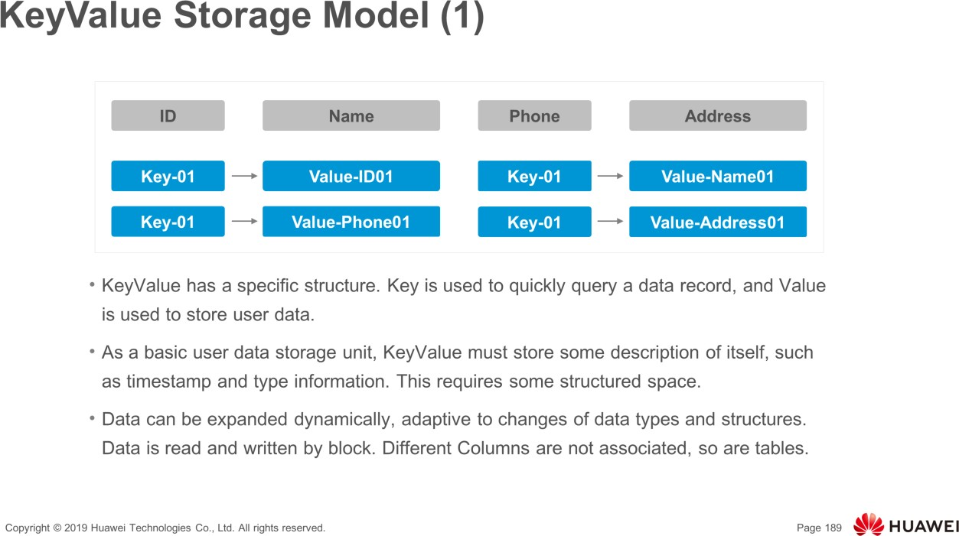

Slide 19
Contents
Introduction to HBase
HBase Related Concepts
HBase Architecture
HBase Key Processes
HBase Highlights
HBase Performance Tuning
Common HBase Shell Commands

Slide 20
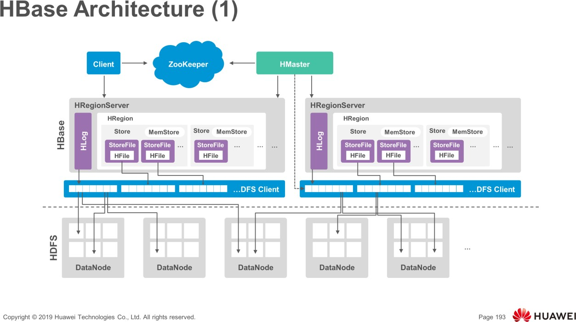
ZooKeeper provides distributed coordination services for processes in the HBase cluster.
Each RegionServer is registered with ZooKeeper so that the active Master can obtain the health status of each RegionServer.
Client communicates with HMaster and RegionServer by HBase's RPC mechanism.
The Client communicates with HMaster for management and communicates with RegionServer for data operation.

Slide 21
RegionServer provides read and write services of table data as a data processing and computing unit in Hbase. RegionServer is usually deployed together with the DataNode of the HDFS cluster to perform data storage.

Slide 22
HMaster involves the active Master and standby Master In HA mode.
  Active Master: manages RegionServers in HBase, including the creation, deletion, modification, and query of a table, balances the load of RegionServers, adjusts the distribution of Regions, splits Regions and distributes Regions after they are split, and migrates Regions after a RegionServer failed.

Slide 23
  Standby Master: Takes over services when the active Master fails. The original active Master serves as the standby Master when the fault is rectified.
HDFS provides highly reliable file storage services for HBase. All HBase data is stored in the HDFS.

Slide 24
HBase Architecture (2)
●
The HBase architecture consists of the following functional components:
❐
Library functions (linking to each client)
HMaster HRegionServer
❐
❐

Slide 25
HBase Architecture (3)
The HMaster server manages and maintains the partition information in the HBase table, maintains the HRegionServer list, allocates regions, and balances loads.
●
HRegionServer stores and maintains the allocated regions and process read and write requests from clients.
●
The client does not directly read data from HMaster. Instead, the client directly reads
data from HRegionServer after obtaining the storage location of the region.
●
The client does not depend on the HMaster. Instead, the client obtains the region location through ZooKeeper. Most clients do not even communicate with the HMaster. This design reduces the load of the HMaster.
●

Slide 26
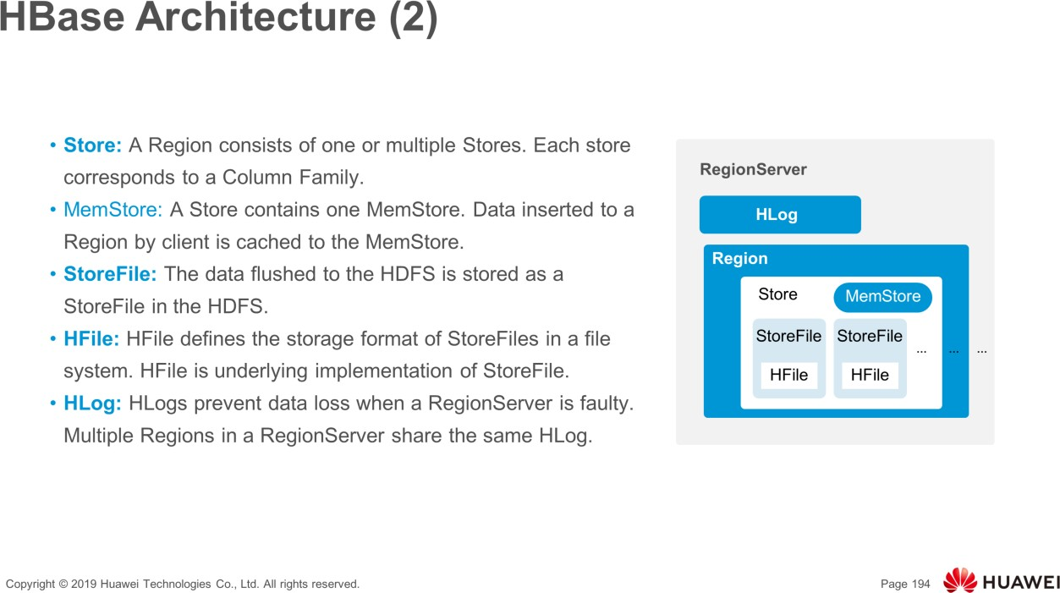
MemStore: When the MemStore capacity reaches the upper limit, RegionServer flushes data in MemStore to HDFS.
StoreFile: As more data is inserted, multiple StoreFiles are generated in a Store. When the number of StoreFiles reaches the upper limit, RegionServer merges multiple StoreFiles into a big StoreFile.

Slide 27
HBase Architecture (4)
●
Table
Region
(HBase table)
(Regions for the table)
■
Store
(Store per ColumnFamily for each Region for the table)
MemStore
StoreFile
~ Block
(MemStore for each Store for each Region for the table)
(StoreFiles for each Store for each Region for the table)
(Blocks within a StoreFile within a Store for each Region for the table)

Slide 28
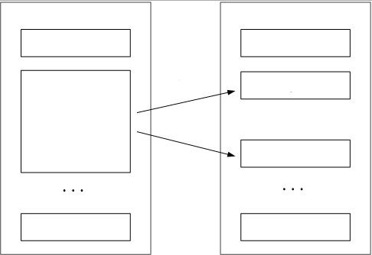
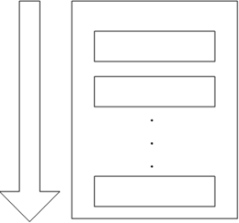
Table and Region
In normal cases, an HBase table has only one region. As the data volume increases, the HBase table is split into multiple regions.
●
The region splitting operation is fast because the region still reads the original storage file after the splitting.
●
Table Region
Table Region
Table
Region
By row key lexicographical order
Split
Region
Region
Region
Region
Region
Region
Region

Slide 29
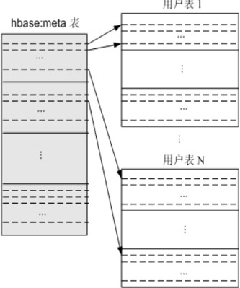
Region Positioning (1)
●
Region is classified into Meta Region and User Region.
Meta Region records the routing information of each User Region.
User table1
●
Hbase:meta table
To read and write region data routing information, perform the following steps:
●
User table N
❐
Find the Meta Region address.
Find the User Region address based on Meta Region.
❐

Slide 30
Region Positioning (2)
●
To speed up access, the hbase:meta table is saved in memory.
Assume that each row (a mapping entry) in the hbase:meta table occupies
about 1 KB in the memory, and the maximum size of each region is 128 MB.
In the two-layer structure, 2¹⁷ (128 MB/1 KB) regions can be saved.
●
●

Slide 31

Client
The client contains the interface for accessing HBase and maintains the location information of the accessed regions in the cache to accelerate subsequent data access.
●
The client queries the hbase:meta table first, and determines the location of the region. After the required region is located, the client directly accesses the corresponding region (without passing through the HMaster) and initiates a read/write request.
●

Slide 32
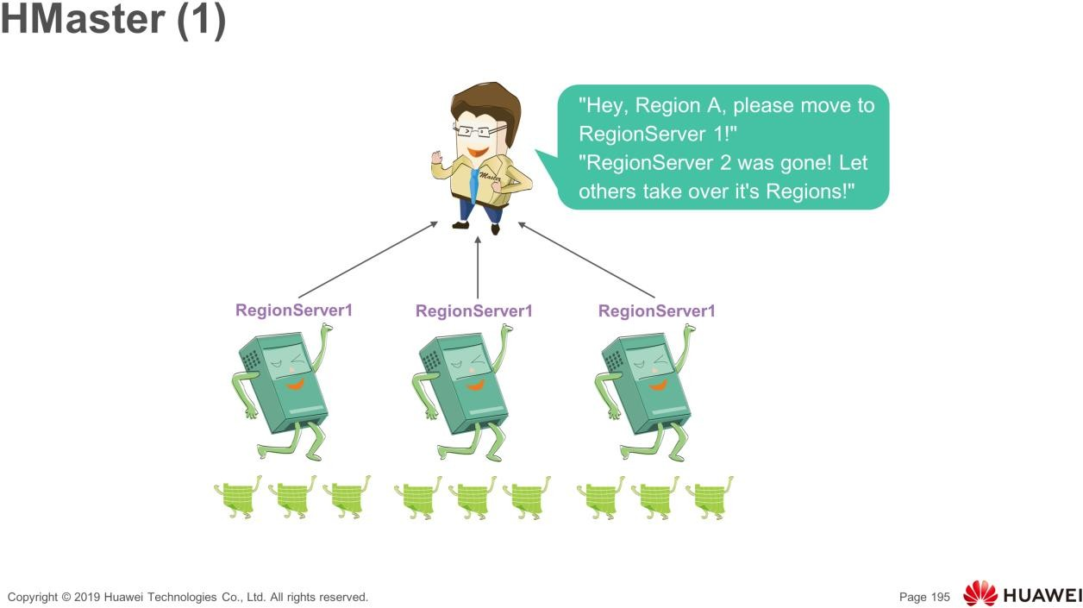
HMaster involves the active Master and standby Master In HA mode.
  Active Master: manages RegionServers in HBase, including the creation, deletion, modification, and query of a table, balances the load of RegionServers, adjusts the distribution of Regions, splits Regions and distributes Regions after they are split, and migrates Regions after a RegionServer failed.
  Standby Master: Takes over services when the active Master fails. The original active Master serves as the standby Master when the fault is rectified.

Slide 33
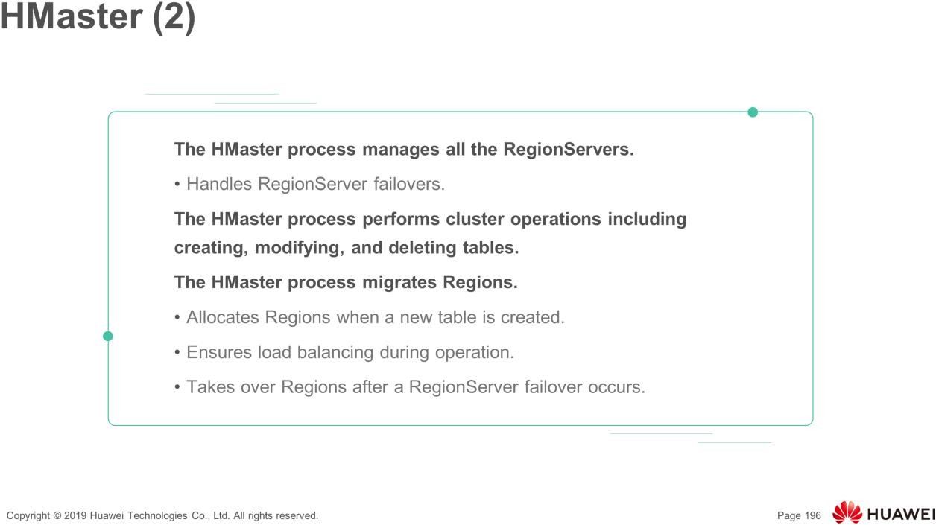
HMaster is in active/standby mode. A cluster can have two HMaster processes. When the cluster starts, the processes compete for being the active HMaster process. There is only one active HMaster process. and the standby HMaster process is in the standby status and does not involve in cluster transactions when the cluster is running.

Slide 34
HMaster HA
ZooKeeper can help elect an HMaster node as the primary management node of the cluster and ensure that there is only one HMaster node running at any time, preventing single point of failures (SPOFs) of the HMaster node.
●

Slide 35
HMaster
The HMaster server manages tables and regions by performing the following operations:
●
Manages users' operations on tables, such as adding, deleting, modifying, and querying.
❐
❐
Implements load balancing between different HRegionServers.
Adjusts the distribution of regions after they are split or merged. Migrates the regions on the faulty HRegionServers.
❐
❐

Slide 36
HRegionServer
HRegionServer is the core module of HBase. It provide the following main functions:
●
❐
Maintains the regions allocated.
Responds to users' read and write requests.
❐

Slide 37
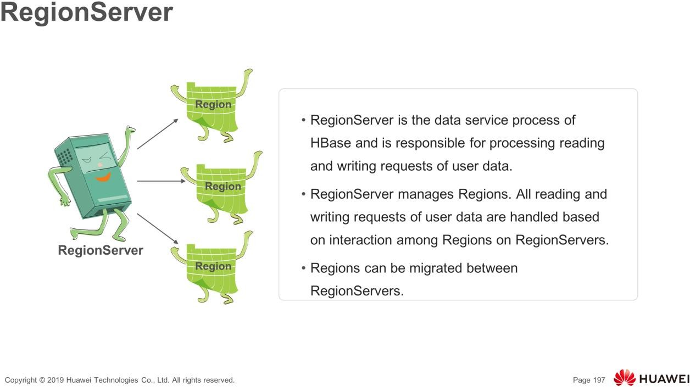

Slide 38
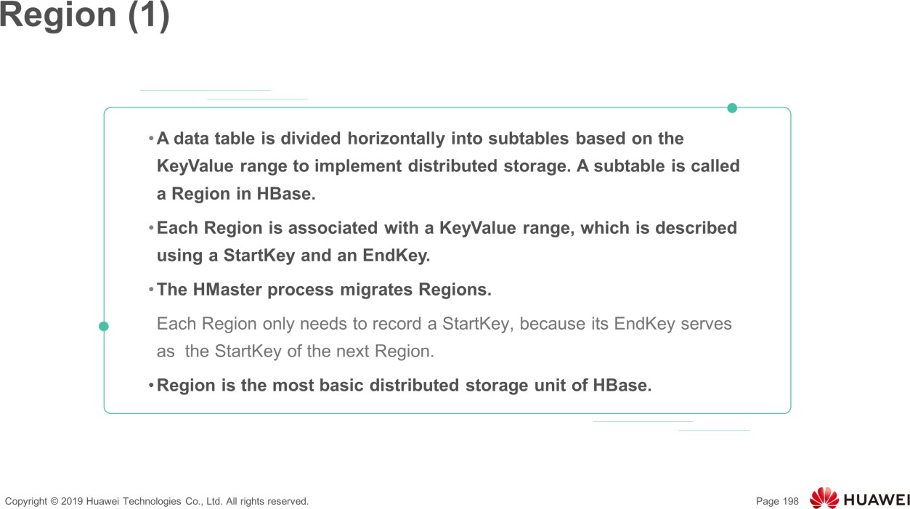

Slide 39
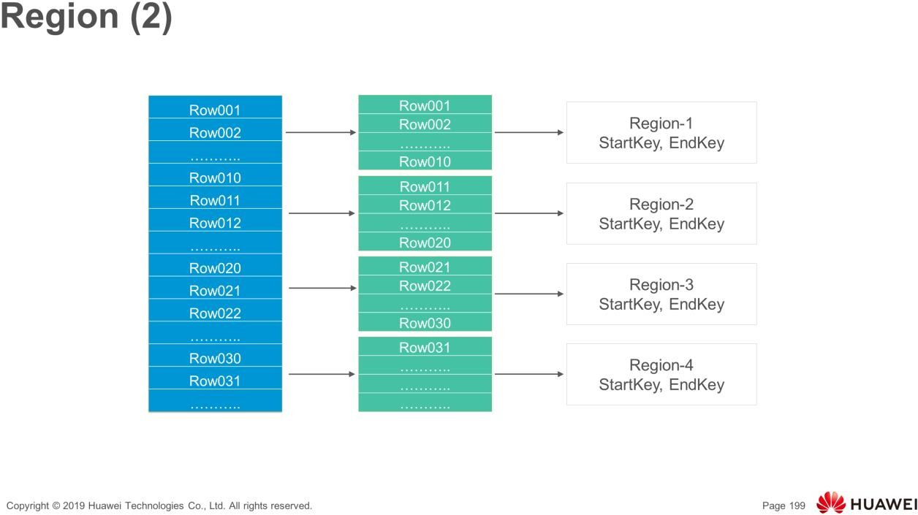
First region (region-1) has the start key row001, while (region-2) has the start key row011

Slide 40
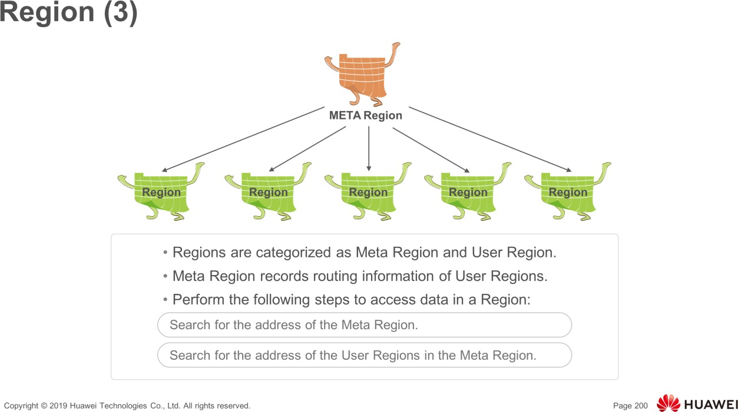
2 types of regions(Mata regions, User regions)
The address of Meta Region is stored in the -ROOT- Table in ZooKeeper.
The address of User Region is stored in the .META. Table.

Slide 41
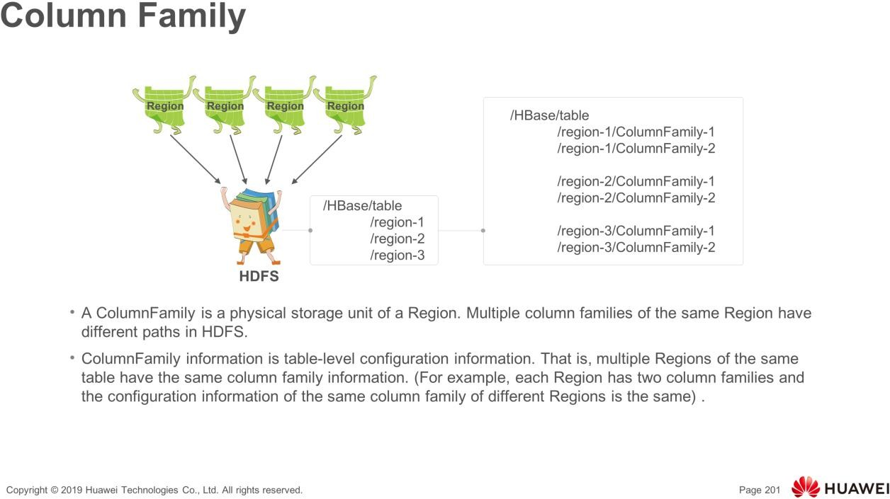
Column Family: A table consists of one or multiple Column Families horizontally. A Column Family can consist of columns. A column is a label under the column family, which can be added as required when data is written. The column family supports dynamic expansion so the number and type of columns do not need to be predefined. Columns of a table in HBase are sparsely distributed. The number and type of columns in different rows can be different.

Slide 42
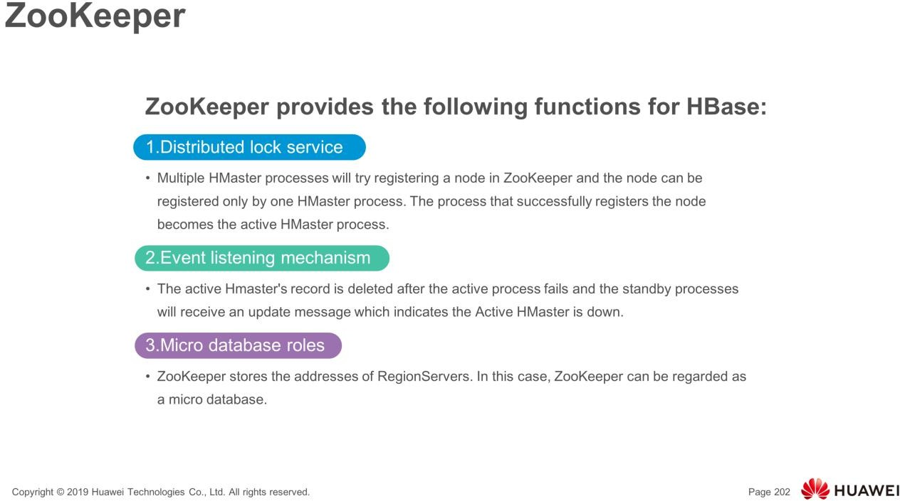
Zookeeper provides distributed coordination services for processing Hbase cluster
Each region server is register with the zookeeper so that active Hmaster can obtain the health status of each region server.
.

Slide 43
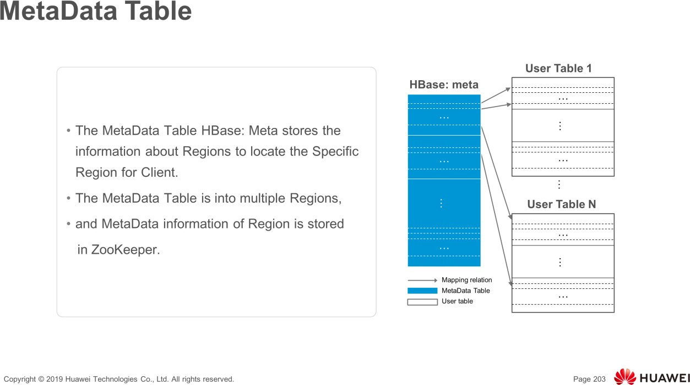
MetaData records information about the location of Region, start RowKey and end RowKey, etc.
regionID+regionserverID as metadata to record the relationship between region and its region server.

Slide 44
Contents
Introduction to HBase
HBase Related Concepts
HBase Architecture
HBase Key Processes
HBase Highlights
HBase Performance Tuning
Common HBase Shell Commands

Slide 45
Data Read and Write Process
When you write data, the data is allocated to the corresponding HRegionServer for execution.
●
●
Your data is first written to MemStore and HLog.
The commit() invocation returns the data to the client only after the operation is written to HLog.
When you read data, the HRegionServer first accesses MemStore cache. If the MemStore cache cannot be found, the HRegionServer searches StoreFile on the disk.
●
●

Slide 46
Cache Refreshing
The system periodically writes the content in the MemStore cache to the StoreFile file in the disk, clears the cache, and writes a tag in the HLog.
●
A new StoreFile file is generated each time data is written. Therefore, each Store contains multiple StoreFile files.
●
Each HRegionServer has its own HLog file. Each time the HRegionServer is started, the HLog file is checked to confirm the latest startup. Check whether a new write operation is performed after the cache is refreshed. If an update is detected, the data is written to MemStore and then to StoreFile. At last, the old HLog file is deleted, and HRegionServer provides services for you.
●

Slide 47
Merging StoreFiles
A new StoreFile is generated each time data is flushed, affecting the search speed due to the large number of StoreFiles.
●
The Store.compact() function is used to combine multiple StoreFiles into one.
The merge operation is started only when the number of StoreFiles reaches a threshold because the merge operation consumes a large number of resources.
●
●

Slide 48
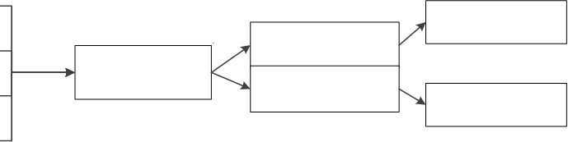
Store Implementation
●
Store is the core of a HRegionServer.
Multiple StoreFiles are combined into one Store.
When the size of a single StoreFile is too large, splitting is triggered. One parent region is split into two sub-regions.
●
●
StoreFile1: 64 MB
StoreFile6: 128 MB
Split
StoreFile2: 64 MB
Combine
StoreFile5A: 128 MB
StoreFile3: 64 MB
StoreFile5: 256 MB
StoreFile5B: 128 MB
StoreFile7: 128 MB
StoreFile4: 64 MB

Slide 49
HLog Implementation
In a distributed environment, you need to consider system errors. Hbase uses HLog to ensure system recovery.
The HBase system configures an HLog file for each HRegionServer, which is a write-ahead log (WAL). (In computer science, write-ahead logging (WAL) is a family of techniques for providing atomicity and durability (two of the ACID properties) in database systems. The changes are first recorded in the log, which must be written to stable storage, before the changes are written to the database).
The updated data can be written to the MemStore cache only after the data is written to logs. In addition, the cached data can be written to the disk only after the logs corresponding to the data cached in the MemStore are written to the disk.
Notes:
Isolation: Every transaction is individual, and One transaction can’t access the result of other transactions until the transaction completed. Or, you can’t perform the same operation using multiple transactions at the same time. We will explain this SQL acid property in a separate article.
Durability: Once the transaction completed, then the changes it has made to the database will be permanent. Even if there is a system failure, or any abnormal changes also, this property will safeguard the committed data.
Atomicity
A transaction must be Atomic, meaning all changes made by the transaction are completed as a single unit, or none of the changes are made. If a partial transaction were committed, the atomic property is violated, and the database is left in an inconsistent state. The ability to commit or roll back transactions is required for Atomicity.
Consistency
The transaction must preserve database Consistency, which means that the database must begin the transaction in a state of consistency and return to a state of consistency when the transaction is complete.

Slide 50
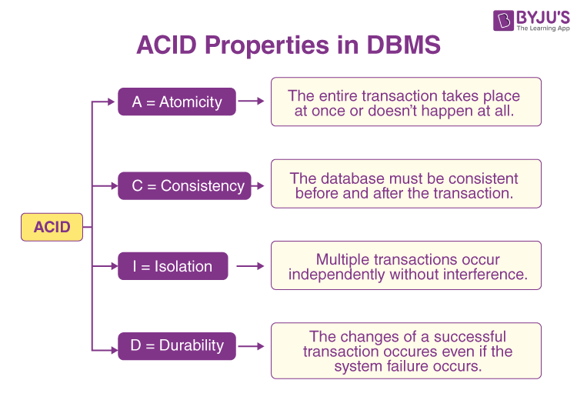

Slide 51
Contents
Introduction to HBase
HBase Related Concepts
HBase Architecture
HBase Key Processes
HBase Highlights
HBase Performance Tuning
Common HBase Shell Commands

Slide 52
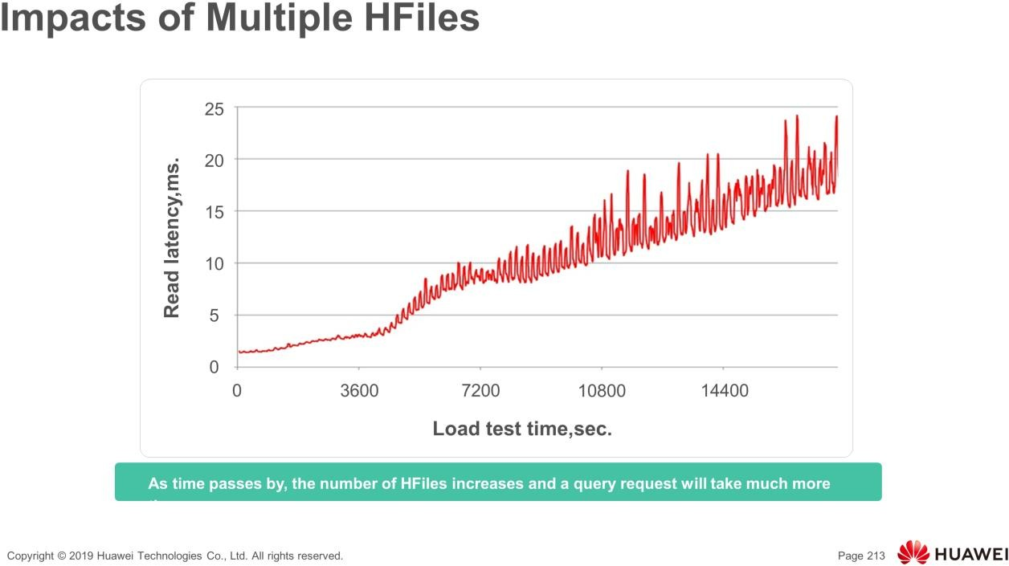
As time passes by, the number of HFiles increases because service data flows to the HBase cluster. More files need to be opened for the same query, so the query latency increases.

Slide 53
Compaction (1)
Compaction is used to reduce the number of small files (HFiles) in the same column family of the same region to improve the read performance.
●
●
Compaction is classified into minor compaction and major compaction.
Minor: indicates small-scale compaction. There are limits on the minimum and maximum number of files. Generally, small files in a continuous time range are merged.
❐
Major: indicates the compaction of all HFile files under the column family of the region.
❐
❐
Minor compaction complies with a certain algorithm when selecting files.

Slide 54
Compaction - 2
Write
put
MemStore
Flush
HFile HFile HFile HFile HFile HFile HFile
Minor Compaction
HFile HFile HFile
Major Compaction
HFile

Slide 55


OpenScanner
In the OpenScanner process, two different scanners are created to read HFile and MemStore data.
●
❐
The scanner corresponding to HFile is StoreFileScanner.
The scanner corresponding to MemStore is MemStoreScanner.
❐
ColumnFamily-1 MemStore
HFile-11
HFile-12
Region
ColumnFamily-2
MemStore
HFile-21 HFile-22

Slide 56
BloomFilter
BloomFilter is used to optimize some random read scenarios, that is, the Get scenario. It can be used to quickly determine whether a piece of user data exists in a large data set (most data in the data set cannot be loaded to the memory).
●
BloomFilter has possibility of misjudgment when determining whether a piece of data exists. However, the judgment result of "The data xxxx does not exist" is reliable.
●

Slide 57
Contents
Introduction to HBase
HBase Related Concepts
HBase Architecture
HBase Key Processes
HBase Highlights
HBase Performance Tuning
Common HBase Shell Commands

Slide 58
Row Key
Row keys are stored in alphabetical order. Therefore, when designing row keys, you need to fully use the sorting feature to store the data that is frequently read together and the data that may be accessed recently.
●
For example, if the data that is recently written to the HBase table is most likely to be accessed, you can use the timestamp as a part of the row key. Because the data is sorted in alphabetical order, you can use Long.MAX_VALUE - timestamp as the row key, in this way, newly written data can be quickly hit when being read.
●

Slide 59
Creating HBase Secondary Index (1)
●
HBase has only one index for row keys.
There are three methods for accessing rows in the HBase table:
●
❐
Access through a single rowkey
Access through a row key interval Full table scan
❐
❐

Slide 60
Creating HBase Secondary Index (2)
●
Hindex Secondary Index
Hindex is a Java-based HBase secondary index developed by Huawei and is compatible with Apache HBase 0.94.8. The current features are as follows:
❐
■
Multiple table indexes
Multiple column indexes
Index based on some column values
■
■

Slide 61
Contents
Introduction to HBase
HBase Related Concepts
HBase Architecture
HBase Key Processes
HBase Highlights
HBase Performance Tuning
Common HBase Shell Commands

Slide 62
Common HBase Shell Commands
●
create: creating Hbase tables
list: listing all tables in HBase
put: adding data to a specified cell in a table, row, or column
scan: browsing information about a table
get: obtaining the value of a cell based on the table name, row, column, timestamp, time range, and version number
enable/disable: enabling or disabling a table
drop: deleting a table
●
●
●
●
●
●

Slide 63
Summary
This course describes the knowledge about the HBase database. HBase is an open source implementation of BigTable. Similar to BigTable, HBase supports a large amount of data and distributed concurrent data processing. It is easy to expand, supporting dynamic scaling, and is applicable to inexpensive devices.
●
Additionally, this course describes the differences between the conceptual view and physical view of HBase data. HBase is a mapping table that stores data in a sparse, multi-dimensional, and persistent manner. It uses row keys, column keys, and timestamps for indexing, and each value is an unexplained string.
●

Slide 64
Quiz
Which of the following is type used to store data in HBase? ( )
  Int
  Long
  String
  Byte[]

Slide 65
Quiz
What is the smallest storage unit of HBase? ( )
  Region
  Column Family
  Column
  Cell

Slide 66
Recommendations
●
Huawei Cloud Official Web Link:
https://www.huaweicloud.com/intl/en-us/
Huawei MRS Documentation:
https://www.huaweicloud.com/intl/en-us/product/mrs.html
Huawei TALENT ONLINE:
https://e.huawei.com/en/talent/#/
●
●

Slide 67

Thank you.
Copyright©2020 Huawei Technologies Co., Ltd. All Rights Reserved.
The information in this document may contain predictive statements including, without limitation, statements regarding the future financial and operating results, future product portfolio, new technology, etc. There are a number of factors that could cause actual results and developments to differ materially from those expressed or implied in the predictive statements.
Therefore, such information is provided for reference purpose only and constitutes neither an offer nor an acceptance. Huawei may change the information at any time without notice.

